Slide 1
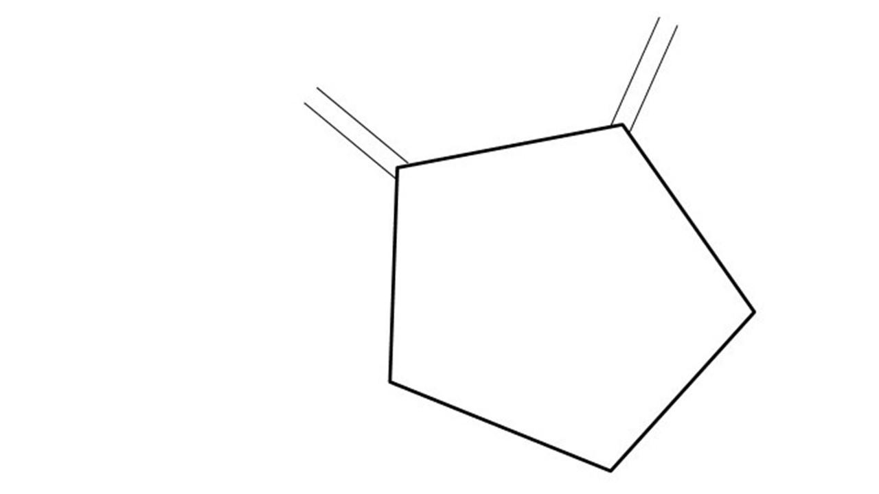
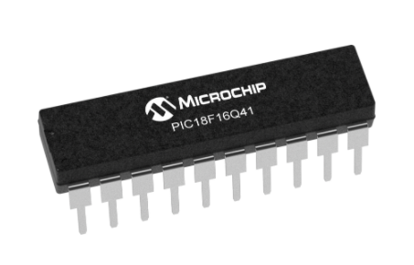
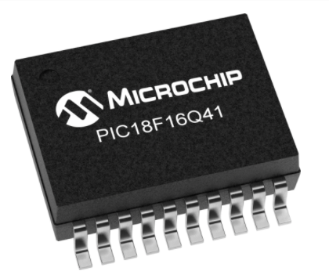
Great Cow BASIC Part 15
Great Cow BASIC for the PIC18FxxQ41 chip Family
January 2021

Slide 2
PIC18FxxQ41
PIC18-Q41 is a high performance PIC18
Digital and Analog peripherals
12-bit ADC
Multiple communication interfaces
Serial, I2C, SPI
PWM – CCP/PWM and 16Bit
Configurable Logic Cells
The PIC18xxQ41 offers 14- and 20-pin products in small footprint packages to support customers in a variety of space constrained and sensor node applications.

Slide 3
Videos...
Install the hardware and make the board work – three LED programs
Make four LEDs flash in a sequence
Set the LEDs to represent the value of ADC
Sequence the LEDs with a delay using the value of ADC
Using an input to set the state of the LED
Using the reset switch
Using the switch, ADC – the LEDs flash in a sequence with reverse
Using the serial to display values
Using the timer0 overflow, 8bit timer, 16bit timer to flash the LEDs
Using CCP/PWM to dim the LEDS
Using I²C with serial to discover I2C devices
Using EEProm – showing values on the serial terminal
Using an I²C GCLD display
Using an SPI GCLD display
Using PWM to dim the LEDS
Using memory within the PIC – Progmem and SAF memory
The Great Cow BASIC tool chain
Assembly and alternatives assemblers
Summary

Slide 4
Great Cow BASIC Compiler
Great Cow BASIC is an Open Source compiler for PIC and AVR microcontrollers
Great Cow BASIC now supports the 18FxxQ41 chip family
Great Cow BASIC Compiler

Slide 5
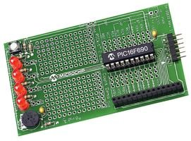
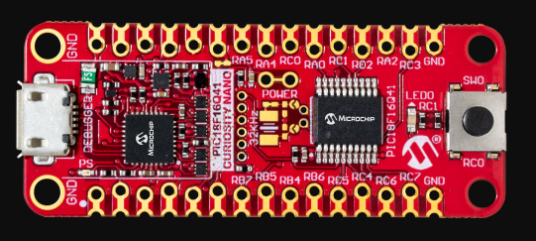

Hardware
Microchip Low Pin Count Demo Board
PICKit_2_Low_Pin_Count_User_Guide_51556a.pdf

Slide 6
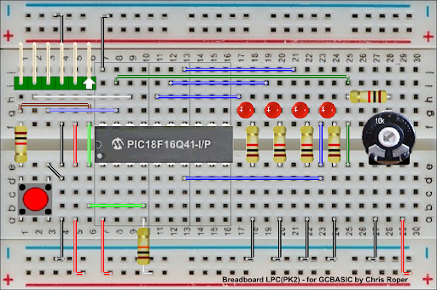
Hardware
Layout
By Chris Roper

Slide 8
Pulse Width Modulation
Pulse Width Modulation ( PWM ) is simply a succession of pulses – is a method of reducing the average power delivered by an electrical signal, by effectively chopping it up into discrete parts.
The average value of voltage (and current) fed to the load is controlled by turning on and off at a fast rate. The longer the signal is on compared to the off periods, the higher the total power supplied to the load.

Slide 9
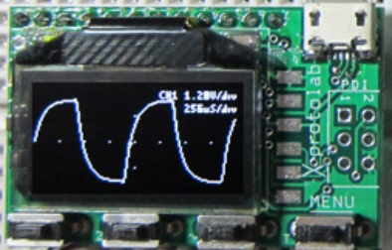
Setup
http://www.gabotronics.com/development-boards/xmega-xminilab.htm

Slide 10
PWM
 | PWM type | Chararcteristics | PPS required | Comment
1 | The software way | A number of pulses | No | Any port**
2 | CCP/PWM | Fixed frequency, fixed duty using timer2* | Yes – CCP/PWMx module | Low code impact, two constants
3 | CCP/PWM | Variable frequency, variable duty using timer2* | Yes – CCP/PWMx module | See tutorial #10
4 | PWM 16 bit | Wide range of capabilities | Yes - PWMxx | Lots of parameters
* could use other timers
** any valid output

Slide 11
Lab
Walk the examples
View the scope

Slide 13
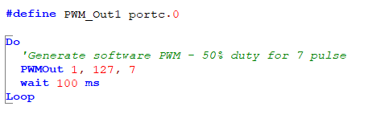
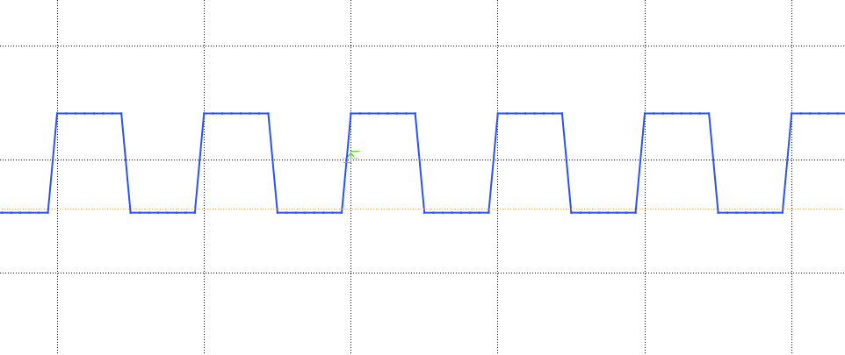
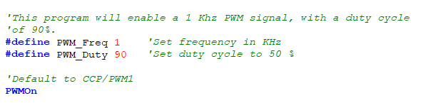
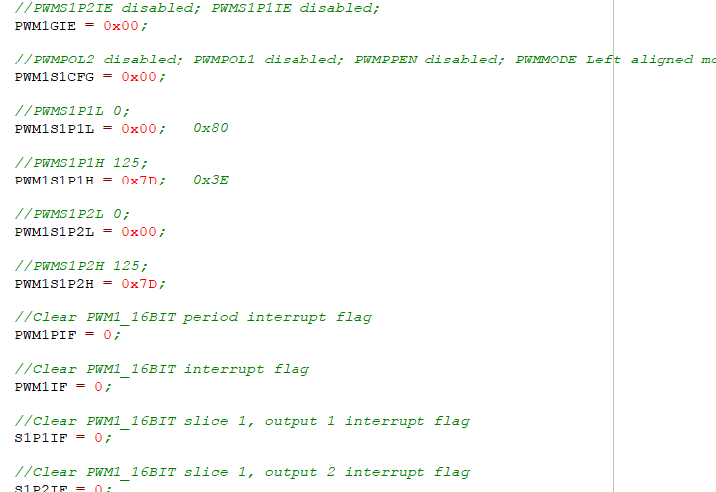
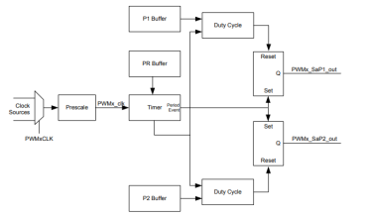
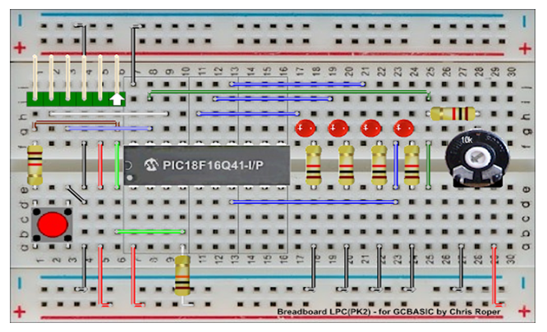
PWM

Slide 14
Videos...
Install the hardware and make the board work – three LED programs
Make four LEDs flash in a sequence
Set the LEDs to represent the value of ADC
Sequence the LEDs with a delay using the value of ADC
Using an input to set the state of the LEDs
Using the reset switch
Using the switch, ADC – the LEDs flash in a sequence with reverse
Using the serial to display values
Using the timer0 overflow, 8bit timer, 16bit timer to flash the LEDs
Using CCP/PWM to dim the LEDS
Using I2C with serial to discover I2C devices
Using EEProm – showing values on the serial terminal
Using an I2C GCLD display
Using an SPI GCLD display
Using PWM to dim the LEDS
Using memory within the PIC – Progmem and SAF memory
The Great Cow BASIC tool chain
Assembly and alternatives assemblers
Summary

Slide 15
Great Cow BASIC
Great Cow BASIC for the PIC18FxxQ41 chip Family
January 2021

Slide 17
Backup Slides

Slide 18
PWM

